Slide 1
Understanding Crates
Crate essentials
Creating crates via rustc
Creating crates via Cargo
Organizing a large app
Annex
Database access application

Slide 2
1. Crate Essentials
What is a crate?
How to create crates?

Slide 3
What is a Crate?
Crates are the fundamental compilation unit of Rust code
There are two kinds of crate:
Binary crates – executable
Library crates – not executable
3

Slide 4
How to Create Crates?
There are two ways to create crates…
Using the rustc compiler
Simple (but not typical)
We'll see how to do this first in this chapter
Using the Cargo tool
Better (easier to define dependencies)
We'll see how to do this later in this chapter
4

Slide 5
2. Creating Crates via rustc
Overview
Creating a binary crate via Rustc
Creating a library crate via Rustc
Utilizing a library crate via Rustc

Slide 6
Overview
In this section we'll see how to create crates directly via rustc
This will help you understand:
Binary crates vs. library crates
How a binary crate can utilize library crates
See this project folder:
crates_via_rustc/
6

Slide 7
Creating a Binary Crate via Rustc
To create a simple binary crate via Rustc…
All you need is a single Rust file with a main() function
Compile the code as follows:
This creates a binary crate in helloworld1.exe
fn main() {
println!("Hello, world!");
}
helloworld1.rs
rustc helloworld1.rs
7

Slide 8
Creating a Library Crate via Rustc
To create a simple library crate via Rustc…
All you need is a Rust file with some public artefact(s)
Compile the code as follows:
This creates a library crate in libmath.rlib
pub fn add(left: u64, right: u64) -> u64 {
left + right
}
math.rs
rustc math.rs --crate-type=lib
8

Slide 9
Utilizing a Library Crate via Rustc
Let's see how to utilize a library crate via Rustc
E.g., from another binary crate
Compile the code as follows:
This creates a binary crate that references the library crate
fn main() {
println!("Hello, world!");
let res = math::add(10, 20);
print!("Sum is {}", res);
}
helloworld2.rs
rustc helloworld2.rs --extern math=libmath.rlib
9

Slide 10
3. Creating Crates via Cargo
Overview
Creating a binary crate via Cargo
Creating a library crate via Cargo
Utilizing a library crate via Cargo

Slide 11
Overview
In this section we'll see how to create crates via Cargo
This is the preferred way to create crates
Cargo generates starter files for you
You can manage crate dependencies via .toml files
See this project folder:
crates_via_cargo/
11

Slide 12
Creating a Binary Crate via Cargo
To create a binary crate via Cargo…
This generates a package that contains:
src/main.rs – Root code file in the binary crate
Cargo.toml - Specifies package metadata and dependencies
When you build the package:
Cargo creates a binary crate in myapp1.exe
cargo new myapp1
or
cargo new myapp1 --bin
12

Slide 13
Creating a Library Crate via Cargo
To create a library crate via Cargo…
This generates a package that contains:
src/lib.rs - Root code file in the library crate
Cargo.toml - Specifies package metadata and dependencies
When you build the package:
Cargo creates a library crate in libmylib.rlib
cargo new mylib --lib
13

Slide 14
Utilizing a Library Crate via Cargo
Imagine you've created a library crate and a binary crate like so:
In the binary crate .toml file, add a dependency that points to the path of the library:
cargo new mylib --lib
cargo new myapp2 --bin
[package]
name = "myapp2"
version = "0.1.0"
edition = "2024"
[dependencies]
mylib = { path = "../mylib" }
Cargo.toml in myapp2
14

Slide 15
4. Organizing a Large App
Overview
Understanding the project structure
Understanding the library crate
Understanding the binary crate

Slide 16
Overview
In this section we'll see how to structure a large application
See project folder csv_parser/
This will help you to understand:
The interplay between binary and library crates
How to organize code into separate files (modules)
16

Slide 17
Understanding the Project Structure
The project (package) contains two crates:
Binary crate – contains just the main() function
Library crate – contains all the rest of the application code
Interestingly, both crates will be named csv_parser
The binary crate will be built in csv_parser.exe
The library crate will be built in libcsv_parser.rlib
17

Slide 18
Understanding the Library Crate (1 of 2)
lib.rs is the root code file of the library crate
It just defines a bunch of modules as follows:
Rust will automatically locate the code for these modules in files named datatypes.rs etc.
pub mod datatypes;
pub mod ui;
pub mod fh;
pub mod util;
lib.rs
18

Slide 19
Understanding the Library Crate (2 of 2)
Take a look in the following files (modules) in the library crate:
datatypes.rs - code for the datatypes module
fh.rs - code for the fh module
ui.rs - code for the ui module
util.rs - code for the util module
A module can easily import other modules in the same crate
The crate keyword is a euphemism for the current crate
use crate::{util, datatypes::Record, datatypes::Visit};
ui.rs
19

Slide 20
Understanding the Binary Crate
main.rs is the root code file of the binary crate
main.rs imports modules from the library crate, as follows
Note we have to specify the library crate name specifically here
use csv_parser::{ui, fh, util};
main.rs
Why can't we just use the crate keyword here?
20

Slide 21
Summary
Crate essentials
Creating crates via rustc
Creating crates via Cargo
Organizing a large app

Slide 22
Annex: Database Access App
Overview
Utilizing third-party crates
Specifying crate dependencies
Understanding the application code

Slide 23
Overview
In this section we'll take a look at a realistic demo application
See project folder database-access/
This will help you to understand:
How to utilize third-party Rust crates
How to access a relational database (MySQL)
23

Slide 24
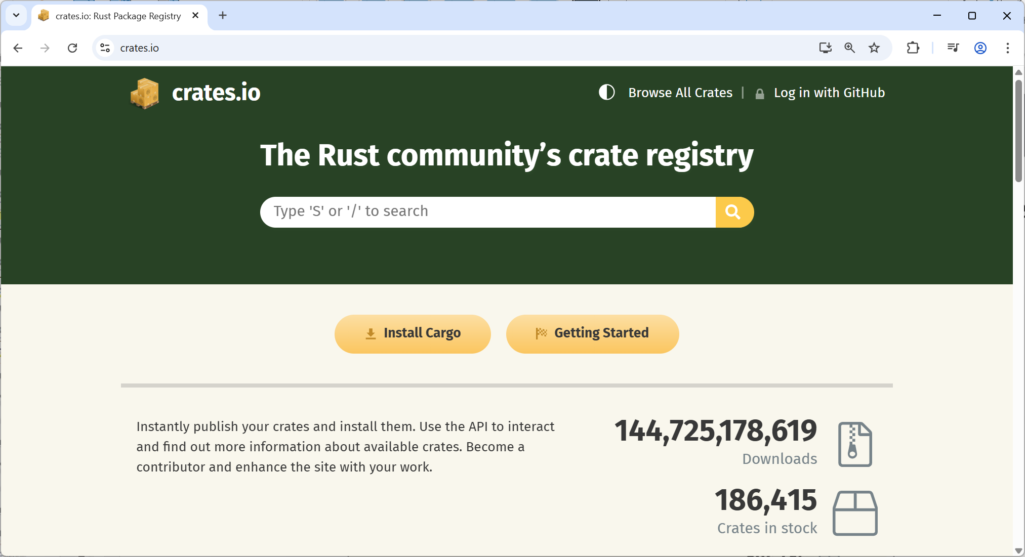
Utilizing Third-Party Crates
There are a large number of third-party Rust crates available
See https://crates.io
24

Slide 25
Specifying Crate Dependencies
If your project depends on any additional crates, specify the dependencies as follows in your Cargo.toml file:
[package]
name = "database_access"
version = "0.1.0"
edition = "2024"
[dependencies]
mysql = "26.0.0"
Cargo.toml in database_access
25

Slide 26
Understanding the Application Code
Take a look at main.rs in the database_access demo
The application does the following:
Connects to a local MySQL instance
Creates a temporary table and inserts some rows
Queries the rows in the table
26

